Slide 1
UAPian Online Library
ID:
16201146
16201134

Slide 2
EnTITY Relationship diagram (erd)
Entity Relationship Diagram, also known as ERD, ER Diagram or ER model, is a type of structural diagram for use in database design. An ERD contains different symbols and connectors that visualize two important information: The major entities within the system scope, and the inter-relationships among these entities.

Slide 3
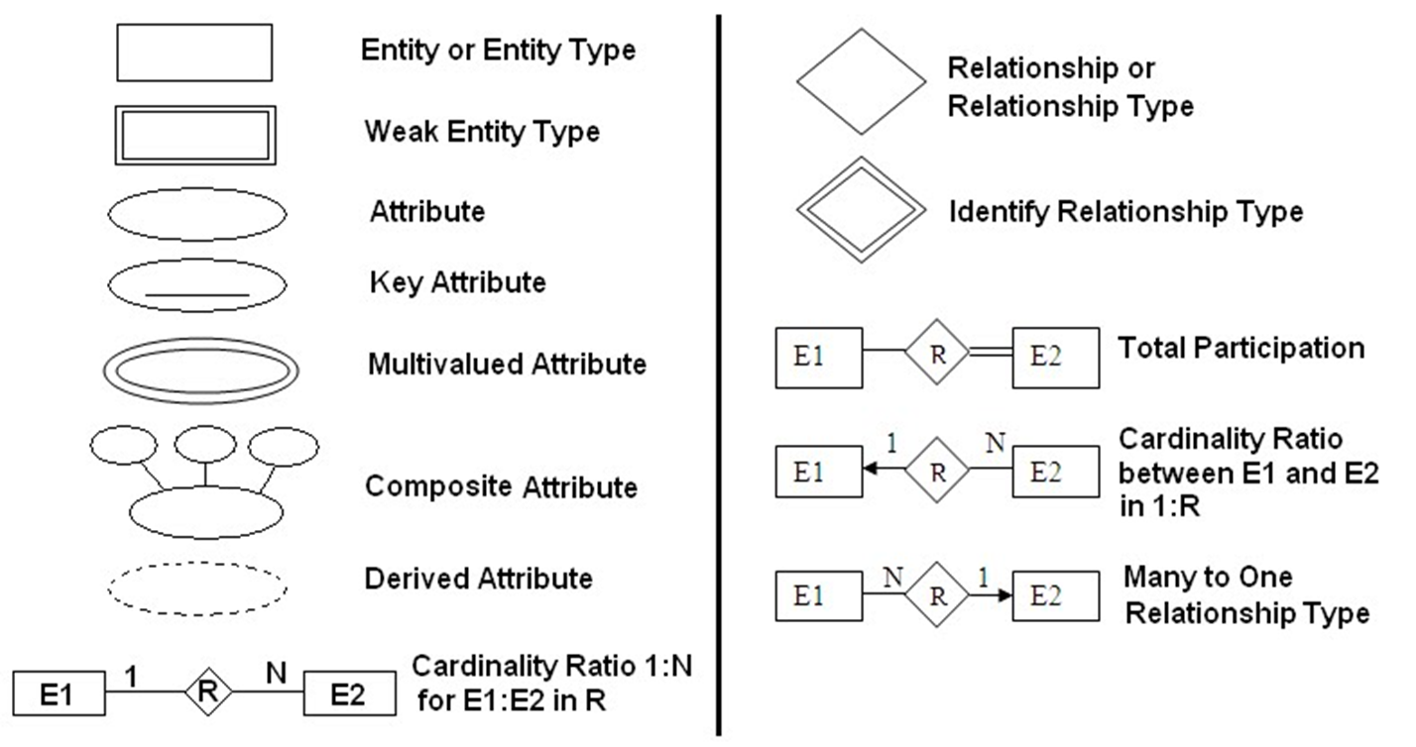
EnTITY Relationship diagram (erd) symbols

Slide 4
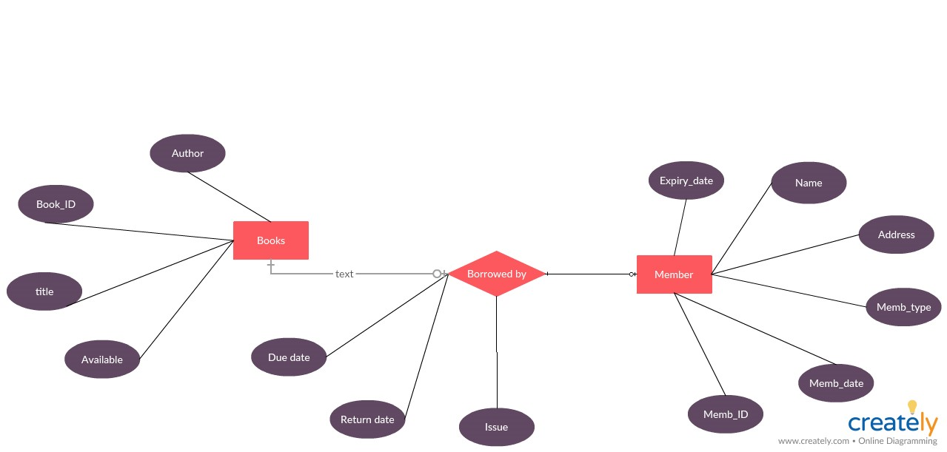

Slide 5
Thank You

